Slide 1
Digital Logic and Design
03-12-2019

Slide 2
Name: J.Saira Banu
Designation: Associate Professor
Email: jsairabanu@vit.ac.in
Cabin: 313 – A28 SJT
Contact Hours: B1/B2 slots
Open Hours: Monday (12.00pm-1.00pm)
Contact: 9894669877 (only 9 am to 5 pm)
Experience:13 years

Slide 3
Syllabus
Unit-1 INTRODUCTION
Number System - Base Conversion- Binary Codes - Complements(Binary and Decimal)
Unit-2 BOOLEAN ALGEBRA
Boolean algebra - Properties of Boolean algebra - Boolean functions Canonical and Standard forms - Logic gates - Universal gates - Karnaugh map - Don’t care conditions - Tabulation Method.
Unit-3 COMBINATIONAL CIRCUIT - I
Adder -Subtractor- Code Converter -Analyzing a Combinational Circuit

Slide 4
Unit 4 COMBINATIONAL CIRCUIT –II
Binary Parallel Adder- Look ahead carry - Magnitude Comparator - Decoders – Encoders - Multiplexers –Demultiplexers
Unit 5 SEQUENTIAL CIRCUITS – I
Flip Flops - Sequential Circuit: Design and Analysis - Finite State Machine: Moore and Mealy model - Sequence Detector
Unit 6 SEQUENTIAL CIRCUITS – II
Registers - Shift Registers - Counters - Ripple and Synchronous Counters - Modulo counters - Ring and Johnson counters

Slide 5
Unit 7 SEQUENTIAL CIRCUITS – II
Bus Organization - ALU - Design of ALU - Status Register - Design of Shifter - Processor Unit -Design of specific Arithmetic Circuits-Accumulator - Design of Accumulator.
Unit 8 RECENT TRENDS
Text Book
1. M. Morris Mano – Digital Logic and Computer Design, Pearson Education India – 1st Edition- 2016, ISBN: 9789332542525.
Reference Books
1. A.P. Malvino, D.P. Leach and GoutamSaha – Digital Principles and Applications(SIE) –Tata McGraw Hill 8th Edition – 2014, ISBN: 9789339203405.
2. M. Morris Mano and Michael D.Ciletti– Digital Design: With an introduction to Verilog HDL - Pearson Education – 5th Edition- 2014. ISBN:9789332535763
3. Thomas Floyd – Digital Fundamentals – Pearson Education-10th Edition – 2011, ISBN: 9788131734483.

Slide 6
Unit-1 Introduction
Digital logic is concerned with the interconnection of digital components and modules.
A term used to define the design and analysis of digital systems.
Examples of digital system
Digital computer (discrete information system)
Telephone switching exchanges
Voltmeters
Frequency counters
Calculating machines

Slide 7
Digital Logic Importance
To understand the function of a computer
- understand the operation of each digital module.
Basic knowledge of the digital system module and its functional behavior.
Study of basic concepts in design and analysis of digital systems ( from gate circuits to complex micro computer systems)

Slide 8
Digital Computer
Memory unit – stores programs, input, output and intermediate data
Processor – performs arithmetic and data processing tasks
Control unit – supervises the flow of information between various units
Input device – means by which the program and data are transferred into the memory
Output device – receives the results of the computations.

Slide 9
Number Systems

Slide 10
Number Systems
Digital computer manipulates discrete elements represented in binary forms.
Every number system has a base or radix r, which gives the number of digits in a particular number system (0 to r-1).
4 number systems that we generally deal with
radix/base
Decimal - 10
Binary - 2
Octal - 8
Hexadecimal - 16

Slide 11
Number Systems
Binary Number System
Base – 2
2 digits – 0 & 1
Ex: 01001₍₂₎, 10101₍₂₎
Octal Number System
Base – 8
8 digits – 0, 1, 2, 3, 4, 5, 6, 7
Ex: 567₍₈₎, 135₍₈₎
Hexadecimal Number System
Base – 16
16 digits – 0 to 9, A to F (10 to 15)
Ex: B49₁₆, FFFF₍₁₆₎

Slide 12
In general, a number in any base r system is expressed as
a_{n}.r^{n} + a_{n-1}.r^{n-1} + … + a₂.r² + a₁.r + a₀ + a₋₁.r⁻¹ + a₋₂.r⁻² + … + a_{-m}.r^{-m}
This expression can also be used to convert any base-r system to decimal system
The Co-efficient values for base r can be only the values less than r.
Ex1: 1010₍₂₎ = 1 x 2³ + 0 x 2 ² + 1 x 2 + 0 x 2⁰
= 8 + 0 + 2 + 0
= 10
Ex2: A29₍₁₆₎ = A x 16² + 2 x 16 + 9
= 2560 + 32 + 9
= 2601

Slide 13
Number Base Conversions

Slide 14
Base Conversion
From base-r to decimal
using the general formula
From decimal to any base-r
repeated division of integer part with the base-r
repeated multiplication of fractional part with the base-r
From any base to any other base( with relation between the bases)
From any base to any other base(Without relation between the bases)
Convert any base to decimal
Decimal to the destination base

Slide 15
Conversion from base – r to decimal
(110101)₂
(4021.2)₅
(127.4)₈
(B65F)₁₆
(10111001110.101)_{b}
(C012.25)_{H}

Slide 16
1. Conversion from base – r to decimal

Slide 17
Number base conversion

Slide 18
Conversion of a number from decimal to base – r
Divide the given decimal number with r and take the remainders in the reverse order
Ex: Convert 25₁₀ to binary
2
25
12
1
6
0
3
0
1
1
Ans: 11001

Slide 19
Conversion of fractions from decimal to base - r
Convert 0.6875 to binary

Slide 20
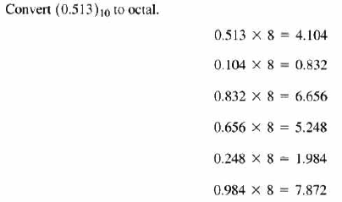

Slide 21
Number Base Conversions
Convert the decimal number 41.6875 to binary ,Octal and hexadecimal.
Convert the decimal number 153.513 to binary ,Octal and hexadecimal.

Slide 22
41.6857
Binary – 101001.1011
Octal - 51.54
Hexadecimal – 29.B
153.513
Binary – 10011001.1000001
Octal - 231.406517
hexadecimal – 99.8353F7

Slide 23
From any base to any other base-with relation
2617.043₈ ---- convert to binary
306.D₁₆ ---- convert to binary
convert to octal
001101100110 011
convert to hexadecimal
10110001101011.11110010

Slide 24
Conversion from octal to binary
2617.043₈
Ex:
010 110 001 111 . 000 100 011₂

Slide 25
Conversion from binary to octal
001 101 100 110 011
(1 5 4 6 3)₈

Slide 26

Conversion between Hexadecimal and Binary
Ex: Binary to Hexadecimal
Hexadecimal to Binary

Slide 27
Base Conversions
(101101) ₂ - base 8
(101101) ₂ - base 4
(101101) ₂ - base 16
(1112) ₄ - base 16
(2012) ₃ - base 9
(432) ₅ - base 25
(2435) ₆ - base 36

Slide 28
Base Conversions
(101101) ₂ - base 8 - 55
(101101) ₂ - base 4 - 231
(101101) ₂ - base 16 - 2D
(1112) ₄ - base 16 - 56
(2012) ₃ - base 9 - 65
(432) ₅ - base 25 - 4H
(2435) ₆ - base 36 - GN

Slide 29
Number base conversion

Slide 30
From any base to any other base-without relation
Convert to base 6: 3BA.25₁₄
Convert to base ‘o’ :(C012.25)_{H}
Convert to hexadecimal : 745.667₈

Slide 31
From any base to any other base-without relation
3BA.25₁₄ = 752.1684₁₀= 3252.1002₆
C012.25_{H} =
745.667₈ = 486.7011₁₀ =1E5.DB8₁₆

Slide 32
Complements
Used for
simplifying subtraction operation
Logical manipulations
2 types of complements
(r – 1)’s complement – diminished radix complement
r’s complement – radix complement

Slide 33
Diminished Radix Complement (r-1)’s complement
Formula for finding (r-1)’s complement is r^{n} – r^{-m} – N, where
n is the number of digits in integer part
m is the number of digits in fraction part
N is the given positive number
r is the radix
Ex:
9’s complement of (52520)₁₀ = 10⁵ – 1 – 52520 = 99999 – 52520 = 47479
9’s complement of 0.3267 = (1 – 10⁻⁴ – 0.3267) = 0.9999 – 0.3267 = 0.6732
9’s complement of 25.639₁₀ = 99.999 – 25.639 = 74.360
1’s complement of 101100₂ = (2⁶ – 1) - (101100) = 111111 – 101100 = 010011

Slide 34
(r-1)’s Complement
Simple way of finding the (r-1)’s complement is to subtract each digit from (r-1) digit.
Ex:
9’s complement of 345 = 999 – 345 = 654
7’ complement of 731₈ = 777 – 731 = 046₈
Simple way of finding 1’s complement in binary system is just to interchange 0’s and 1’s.

Slide 35
r’s complement
Formula => r^{n} – N, where r – radix, n – number of digits in integer part, N – given positive number
Ex:
10’s complement of 52520₁₀ = 10⁵ – 52520 = 47480
2’s complement of 101100₂ = (2⁶)₁₀ – 101100 = 010100₂
Simple way of finding r’s complement is finding (r-1)’s complement and adding 1 to it.
Ex1: 10’s complement of 52520
9’s complement of 52520 = 99999 – 52520 = 47479
10’s complement of 52520 = 47479 + 1 = 47480
Ex2: 10’s complement of 25.639
9’s complement of 25.639 = 99.999 = 74.360
10’scomplement of 25.639 = 74.360 + 00.001 = 74.361
Ex3: 2’s complement of 101100
1’s complement is 010011
2’s complement is 010011 + 1 = 010100

Slide 36
Note
Complement of the complement restores the number to its original.
- r’s complement of N is r^{n} – N
- r’s complement of r^{n} – N is r^{n} - r^{n} +N= N

Slide 37
Problems
(2341)₅--- Find 5’s complement
12398₁₀----Find 9’s complement
100000₂ ---- Find 2’s complement
Find the 10's complement of the number (935)₁₁
The 16-bit 2's complement representation of an integer 1111 1111 1111 0101; What is the its decimal representation.

Slide 38
Binary Codes

Slide 39
Binary Codes
Digital systems use signals that have two distinct values and circuit elements that have two stable states.
direct analogy among binary signals, binary circuit elements, and binary digits
Bit – binary digit
An n-bit binary code is a group of n bits that assumes up to 2^{n} distinct combinations of 1’s and 0’s, with each combination representing one element of the set that is being coded
Minimum number of bits to code 2^{n} distinct quantities is n
Decimal Codes
Requires four bits
Only written for (0-9) digits
Weighted Codes
BCD (Binary Coded Decimal)- 8 4 2 1
5 4 2 1
Biquinary code[ 5 0 4 3 2 1 0 ]
Self Complementary code - (8 4 -2 -1), (2 4 2 1)
Un-Weighted Codes
Excess – 3

Slide 40
BCD
Weights – 8 4 2 1
It is a straight assignment of binary equivalent
BCD equivalent of 395 – 0011 1001 0101
BCD equivalent of 13 – 0001 0011

Slide 41
Weighted code
The representation of the digit is obtained based on the weight assigned to the binary bits according to their positions
Ex: 5 4 2 1
It can be observed that there may be different number of possibilities for a given digit
Ex:
5 in 5 4 2 1 code can be represented as 1 0 0 0 or 0 1 0 1
Similarly 6 can be represented as 1 0 0 1 or 0 1 1 0
Decimal digit | 5 4 2 1
0 | 0 0 0 0
1 | 0 0 0 1
2 | 0 0 1 0
3 | 0 0 1 1
4 | 0 1 0 0
5 | 0 1 0 1
6 | 0 1 1 0
7 | 0 1 1 1
8 | 1 0 1 1
9 | 1 1 0 0

Slide 42
Biquinary code
It is an error detecting code
Consists of totally 7 bit arranged as
[5 0 4 3 2 1 0]
Each decimal digit is represented with 5 zeros and 2 ones.
Eg:
8 – 5 0 4 3 2 1 0
1 0 0 1 0 0 0

Slide 43
Self Complementary Code
9’s complement of the decimal number is obtained by changing 1’s to 0’s and 0’s to 1’s
Ex: 395 in 2 4 2 1 code is 0011 1111 1011
9’s complement of 395 = 604 in 2 4 2 1 is 1100 0000 0100
Examples of self complementary codes – 8 4 -2 -1, 2 4 2 1, 3 3 2 1 etc.
Code for 8 4 -2 -1 is shown here. Similarly it can be obtained for other self complementary codes also.
Decimal digit | 8 4 -2 -1
0 | 0 0 0 0
1 | 0 1 1 1
2 | 0 1 1 0
3 | 0 1 0 1
4 | 0 1 0 0
5 | 1 0 1 1
6 | 1 0 1 0
7 | 1 0 0 1
8 | 1 0 0 0
9 | 1 1 1 1

Slide 44
Excess - 3
No weights – unweighted code
Obtained from the corresponding value of BCD + 3
Self complementary code
Excess – 3 representation of 359 is 0110 1000 1100

Slide 45
Error detection codes
Used to detect errors during transmission
A parity bit is an extra bit included with a message to make the total number of 1’s either odd or even
The message including the parity bit is transferred to the destination
In the receiving end, all the incoming bits are applied to a “parity check” network to check the proper parity adopted.
An error is detected if the checked parity does not correspond to the adopted one.
This method detects only the odd combination of errors

Slide 46
Parity bit generation
Message | P (odd) | P (even)
0000 | 1 | 0
0001 | 0 | 1
0010 | 0 | 1
0011 | 1 | 0
0100 | 0 | 1
0101 | 1 | 0
0110 | 1 | 0
0111 | 0 | 1
1000 | 0 | 1
1001 | 1 | 0
1010 | 1 | 0
1011 | 0 | 1
1100 | 1 | 0
1101 | 0 | 1
1110 | 0 | 1
1111 | 1 | 0

Slide 47
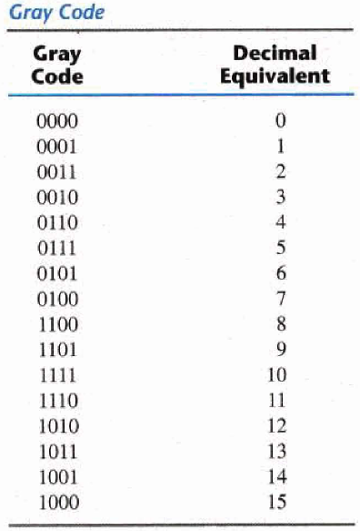
Reflected code
Number in reflected code changes by only one bit as it proceeds from one number to the next.
It is a non weighted code.
Also known as gray code
There are many possible gray codes
One possibility is shown here

Slide 48
Alphanumeric Code
It is a binary code of a group of elements consisting of the ten decimal digits, the 26 letters of alphabets and special symbols.
1. 6 bit code/ alphanumeric code/ Internal code (alphabets+numerals)
2. 7 bit ASCII code (lower case+ upper case+numerals+special control characters)
3. 8 bit EBCDIC –Extended BCD Interchange code(extra one bit for parity)
4. 12 bit binary code for transfering data through punch cards.

Slide 49
ASCII Code

Slide 50
Control Characters in ASCII

Slide 51
Problems
1) What is the radix of the number hold by the equation 312/20 = 13.1?
2) Convert (12)10 to Gray code
3) Convert decimal 11001 to BCD
4) Convert this binary 11001 to BCD
5) Add in base 7: 153₇ + 216 ₇
6) Add in base 16: A28₁₆ + 739₁₆ .
7) Subtract in base 7: 536₇ - 245₇ .
8) Subtract in base 5: 1423₅ - 424₅ .
9) Multiply 32₈ x 5₈
10) Multiply 221₃ x 2 ₃ .
11) 43 ₈ ÷ 7 ₈.
12) 11₃ ÷ 2 ₃.

Slide 52
Subtraction with (r-1)’s complement
Steps:
1. Add the minuend M to (r-1)’s complement of the subtrahend N.
2. Inspect the result obtained in step 1 for an end carry
a) if end carry occurs add 1 to the least significant digit ( end-around carry.
b) if no end carry, take (r-1)’s complement of the number obtained in step1 and place a negative sign in front.

Slide 53
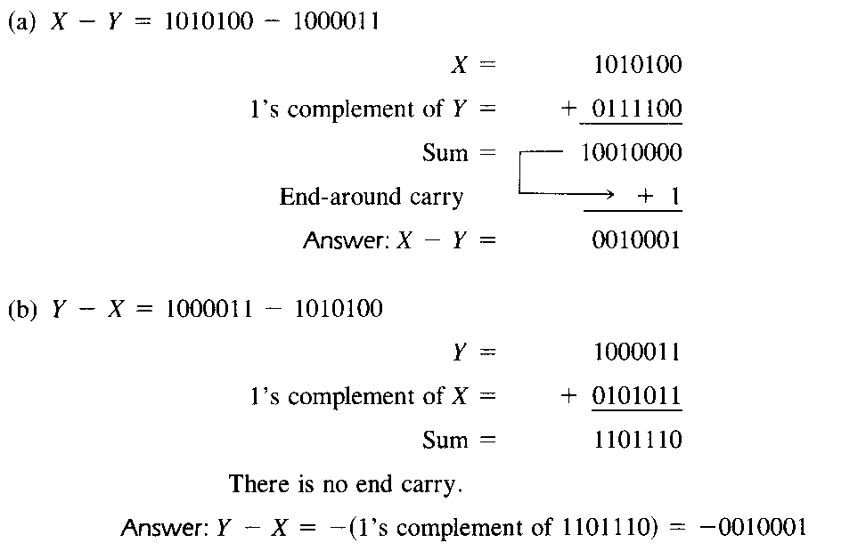
Example

Slide 54
Subtraction with (r-1)’s complement
Using 9’s complement perform subtraction of 72532-3250.
Using 9’s complement perform subtraction of 3250-72532

Slide 55
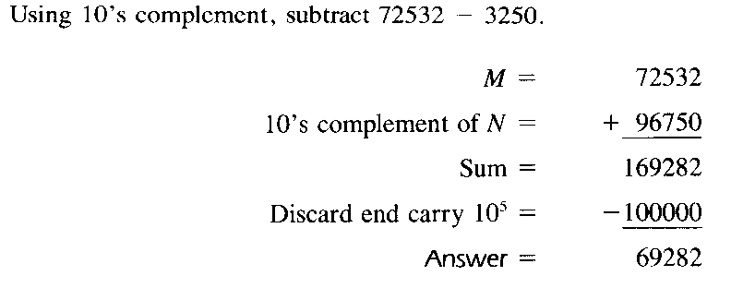
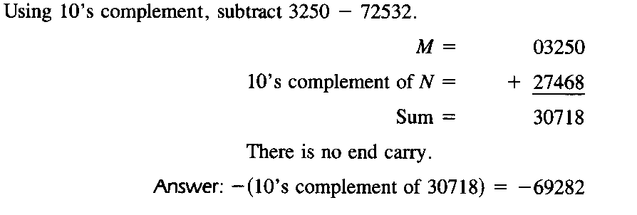

Slide 56
Subtraction with (r)’s complement
Steps:
1. Add the minuend M to (r)’s complement of the subtrahend N.
2. Inspect the result obtained in step 1 for an end carry
a) if end carry occurs discard it
b) if no end carry, take (r)’s complement of the number obtained in step1 and place a negative sign in front.

Slide 57
Problems
1.3, 1.4, 1.5, 1.6, 1.7, 1.8, 1.9, 1.10 from the reference text book specified.

Slide 58
Problems
Convert to base 6: 3BA.25₁₄
(C012.25)_{H} - (10111001110.101)_{B} = ( ?)_{O}
Subtract using r’s complement procedure:
27891₁₀ – 12923₁₀
76425₁₀- 28321₁₀
Subtract using r-1 complement method
(101010)₂-(100010)₂
(453)₇ – (213)₇
How many bytes are needed to represent the decimal value 846569 in BCD, binary and Octal.
Write the following decimal weighted codes: a) 7 4 2 1 b) 5 2 1 1

Slide 59
Problems
Determine the base b in (361)10 = (551)b
The following calculation was performed by a particular breed of unusually intelligent chicken. If the radix r used by the chicken corresponds to its total number of toes, how many toes does the chicken have on each foot?
(35_{r} + 24_{r}) x 21_{r} = 1501_{r}
A typical PC uses 20-bit address code for its memory locations. a) How many hex digits are needed to represent a memory address? b) What is the range of addresses? c) What is the total number of memory locations?
Describe a strategy to convert a base-4 value comprising both integer and fraction parts into its equivalent base-16 value. Hence, convert 31322.32134 into base- 16.
Represent the decimal number 23.45 in BCD, Excess-3, Excess-5 and 6 3 1 1

Slide 60
References
M. Morris Mano – Digital Logic and Computer Design PHI – 5th Edition- 2004. pp. 6 – 12.

